Slide 1




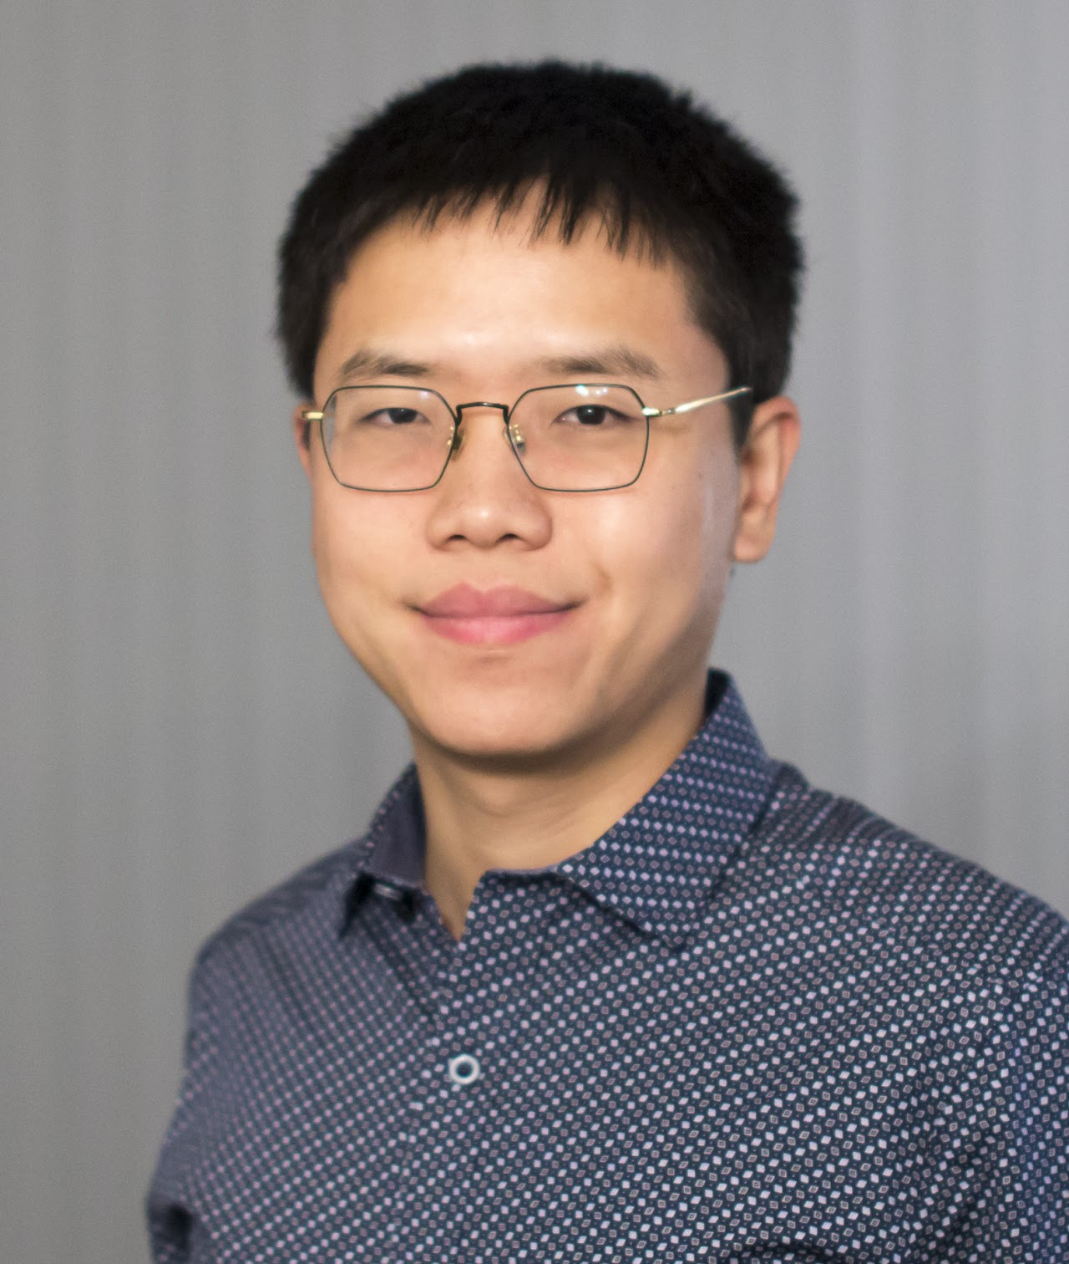


Asynchronous Consensus without Trusted Setup or Public Key Cryptography
Sourav Das
Sisi Duan
Shengqi Liu
Atsuki Momose
Ling Ren
Victor Shoup
souravd2@Illinois.edu
To appear at ACM CCS 2024

Slide 2


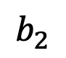
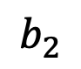
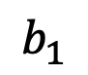
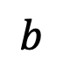
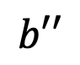
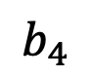
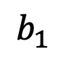
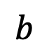
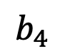
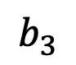
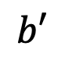
Binary Agreement/Consensus [Lamport 1982]
$n$ party protocol tolerating $t$ failures to agree on a single bit
$$b_{1}$$
$$b$$
$$b_{1}$$
BA
$$b_{2}$$
$$b′$$
$$b_{2}$$
$$b_{3}$$
$$b$$
$$b_{3}$$
$$b_{4}$$
$$b′′$$
$$b_{4}$$
2

Slide 3
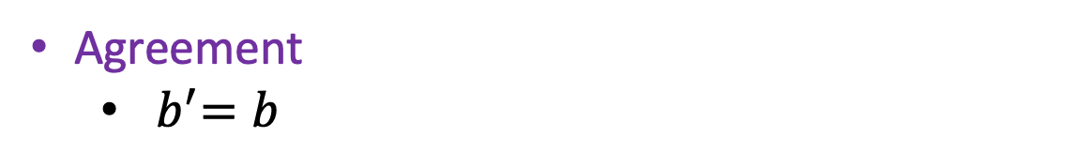
Binary Agreement/Consensus [Lamport 1982]
$n$ party protocol tolerating $t$ failures to agree on a single bit
$$b_{1}$$
$$b$$
$$b_{1}$$
BA
Agreement
${ b}^{′}=b$
$$b_{2}$$
$$b′$$
$$b_{2}$$
$$b_{3}$$
$$b_{3}$$
$$b_{4}$$
$$b_{4}$$

Slide 4
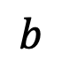
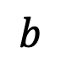
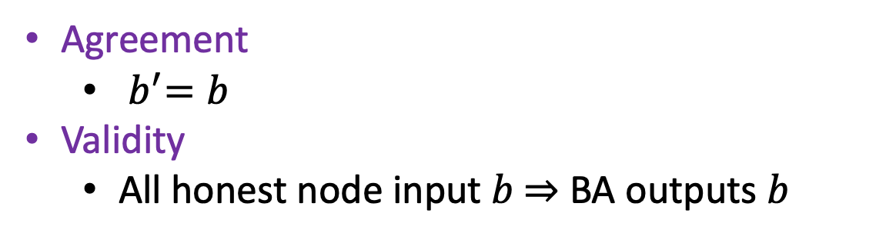
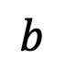
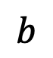
Binary Agreement/Consensus [Lamport 1982]
$n$ party protocol tolerating $t$ failures to agree on a single bit
$$b$$
$$b$$
$$b_{1}$$
BA
Agreement
${ b}^{′}=b$
Validity
All honest node input $b$ $⇒$ BA outputs $b$
$$b$$
$$b$$
$$b_{2}$$
$$b_{3}$$
$$b_{3}$$
$$b$$
$$b$$
$$b_{4}$$

Slide 5
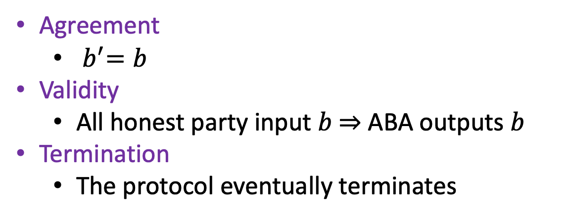
Binary Agreement/Consensus [Lamport 1982]
$n$ party protocol tolerating $t$ failures to agree on a single bit
$$b_{1}$$
$$b$$
$$b_{1}$$
BA
Agreement
${ b}^{′}=b$
Validity
All honest party input $b$ $⇒$ ABA outputs $b$
Termination
The protocol eventually terminates
$$b_{2}$$
$$b$$
$$b_{2}$$
$$b_{3}$$
$$b_{4}$$
$$b$$
$$b_{4}$$

Slide 6
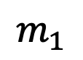
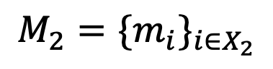
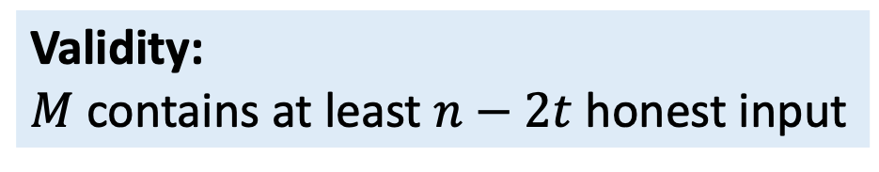
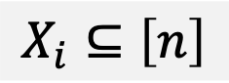
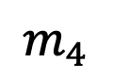
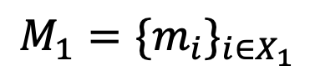
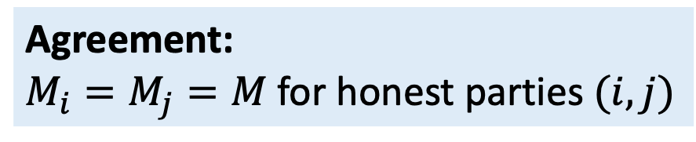
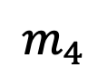
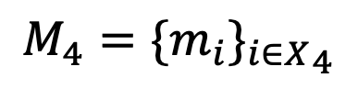
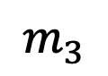
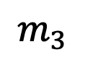
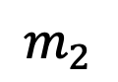
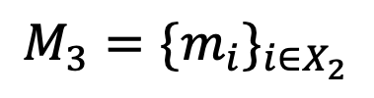
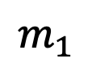
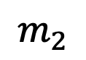
Common Subset or Interactive Consistency
$n$ party protocol tolerating $t$ failures to agree on a subset of inputs
$$m_{1}$$
$$m_{1}$$
$$M_{1}=\{m_{i}\}_{i∈X_{1}}$$
Agreement:
$M_{i}=M_{j}=M$ for honest parties $(i,j)$
CS
$$m_{2}$$
$$M_{2}=\{m_{i}\}_{i∈X_{2}}$$
$$m_{2}$$
Validity:
$M$ contains at least $n−2t$ honest input
$$m_{3}$$
$$M_{3}=\{m_{i}\}_{i∈X_{2}}$$
$$m_{3}$$
$$m_{4}$$
$$M_{4}=\{m_{i}{\}_{i∈X}}_{4}$$
Termination:
The protocol terminates
$$m_{4}$$
$$X_{i}⊆\left[n\right]$$

Slide 7


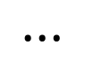
Applications of Common Subset
$n$ party protocol tolerating $t$ failures to agree on a subset of inputs
$$⋯$$
$$m_{1}$$
$$m_{1}$$
$$M_{1}=\{m_{i}\}_{i∈X_{1}}$$
CS
Blockchains
$$m_{2}$$
$$M_{2}=\{m_{i}\}_{i∈X_{2}}$$
$$m_{2}$$
$$m_{3}$$
$$M_{3}=\{m_{i}\}_{i∈X_{2}}$$
$$m_{3}$$
Secure multi-party computation
$$m_{4}$$
$$M_{4}=\{m_{i}{\}_{i∈X}}_{4}$$
$$m_{4}$$
$$X_{i}⊆\left[n\right]$$
Distributed Key Generation

Slide 8






Asynchronous Networks
Definition (Asynchronous Networks):
1. Message delays between honest parties are unbounded
2. Messages must eventually arrive
Great to model communication over the internet!

Slide 9
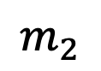
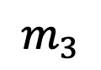
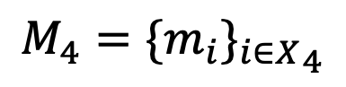
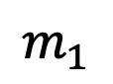
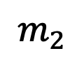
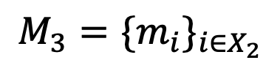
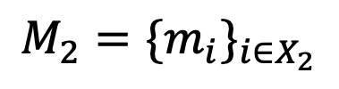
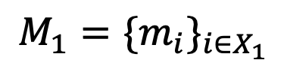
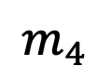
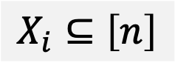
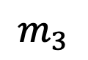
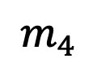
Asynchronous Common Subset (ACS)
Common subset protocol over asynchronous network
$$m_{1}$$
$$m_{1}$$
$$M_{1}=\{m_{i}\}_{i∈X_{1}}$$
ACS
$$m_{2}$$
$$M_{2}=\{m_{i}\}_{i∈X_{2}}$$
$$m_{2}$$
$$m_{3}$$
$$M_{3}=\{m_{i}\}_{i∈X_{2}}$$
$$m_{3}$$
$$m_{4}$$
$$M_{4}=\{m_{i}{\}_{i∈X}}_{4}$$
$$m_{4}$$
$$X_{i}⊆\left[n\right]$$
Deterministic consensus is impossible in asynchronous network [FLP86]

Slide 10

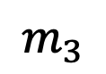
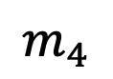
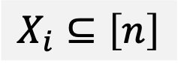








ACS with external common coin
ACS protocols needs to be randomized!
$$m_{1}$$
$$M_{1}=\{m_{i}\}_{i∈X_{1}}$$
How to build an asynchronous common coin protocol?
$$m_{1}$$
ACS
$$m_{2}$$
$$M_{2}=\{m_{i}\}_{i∈X_{2}}$$
$$m_{2}$$
Rely on ACS ☹
$$m_{3}$$
$$M_{3}=\{m_{i}\}_{i∈X_{2}}$$
$$m_{3}$$
ACS
$$m_{4}$$
$$M_{4}=\{m_{i}{\}_{i∈X}}_{4}$$
$$m_{4}$$
$$X_{i}⊆\left[n\right]$$
Common Coin
Common Coin
Circular dependency ☹

Slide 11


Asynchronous Consensus: Prior Works
Protocols | Communication Cost | Expected #Round | Assumptions
AJM+’21, GLL+’22 | $$O\left(κn^{3}\right)$$ | $$O(1)$$ | SXDH, RO
DXKR’22 | $$O({κn}^{3})$$ | $$O(log n)$$ | DDH, RO
Relies on public key cryptography assumption
Insecure against quantum computers [Shor 99]

Slide 12
Asynchronous Consensus: Prior Works
Protocols | Communication Cost | Expected #Round | Assumptions
AJM+’21, GLL+’22 | $$O\left(κn^{3}\right)$$ | $$O(1)$$ | SXDH, RO
DXKR’22 | $$O({κn}^{3})$$ | $$O(log n)$$ | DDH, RO
AGPS’23 ($n≥4t+1$) | $$O(n^{5})$$ | $$O(1)$$ | None
What about information theoretic protocols?

Slide 13

Asynchronous Consensus: Prior Works
Protocols | Communication Cost | Expected #Round | Assumptions
AJM+’21, GLL+’22 | $$O\left(κn^{3}\right)$$ | $$O(1)$$ | SXDH, RO
DXKR’22 | $$O({κn}^{3})$$ | $$O(log n)$$ | DDH, RO
AGPS’23 ($n≥4t+1$) | $$O(n^{5})$$ | $$O(1)$$ | None
This work | $$O({κn}^{3})$$ | $$O(1)$$ | $${RO}^{∗}$$
Can we design a post-quantum secure ACS protocol without setup?
Is it concretely efficient?

Slide 14

















Index ACS
Parties validate each other based on the actions taken by others
$$X_{i}⊆\left[n\right]$$
Agreement:
$$X_{i}=X_{j}=X$$
$$V_{1}$$
$$V_{1}$$
$$X_{1}$$
Index ACS
$$V_{2}$$
$$X_{2}$$
$V_{i}⊆\left[n\right]$ are parties party $i$ has validated
$$V_{2}$$
Validity:
$\left|X\right|≥n−t$
$$V_{3}$$
$$V_{3}$$
$$X_{3}$$
Termination:
Index ACS must terminate*
$$V_{4}$$
$$V_{4}$$
$$X_{4}$$
Index ACS $⇒$ ACS

Slide 15
Background

Slide 16







$\left(n,t\right)$ Threshold Secret Sharing
A mechanism to share a secret $s$ into $n$ shares
$$s_{1}$$
$$s_{2}$$
$$s$$
$$s_{3}$$
$$s_{4}$$
$$s_{5}$$

Slide 17

$\left(n,t\right)$ Threshold Secret Sharing
A mechanism to share a secret $s$ into $n$ shares
Any subset of $t+1$ shares reveal the secret
Any subset of $t$ or less shares reveal nothing about $s$
$$s_{1}$$
$$s_{2}$$
$$s$$
$$s_{3}$$
$$s_{4}$$
$$s_{5}$$

Slide 18








$\left(n,t\right)$ Threshold Secret Sharing
A mechanism to share a secret $s$ into $n$ shares
Any subset of $t+1$ shares reveal the secret
Any subset of $t$ or less shares reveal nothing about $s$
An example of $(5,3)$ threshold secret sharing scheme
$$s_{1}$$
$$s_{2}$$
$${(1,s}_{1})$$
$${(5,s}_{5})$$
$$s$$
$$(0,s)$$
$$s_{3}$$
$${(2,s}_{2})$$
$${(3,s}_{3})$$
$${(4,s}_{4})$$
$$s_{4}$$
$$s_{5}$$

Slide 19





$\left(n,t\right)$ Verifiable Secret Sharing
A protocol to share a secret $s$ into $n$ parties
Any subset of $t+1$ parties can recover the secret
Any subset of $t$ or less parties learn nothing about $s$
An example of $(5,3)$ threshold secret sharing scheme
$$s_{1}$$
$$s_{2}$$
$${(1,s}_{1})$$
$${(5,s}_{5})$$
$$s$$
$$(0,s)$$
$$s_{3}$$
$${(2,s}_{2})$$
$${(3,s}_{3})$$
$${(4,s}_{4})$$
$$s_{4}$$
$$s_{5}$$
Parties can validate that they received valid shares.

Slide 20







Reliable Broadcast (RBC) [Bracha 84]
$$M$$
Broadcaster
$$M$$
$$RBC(M)$$
$$M$$
$$M$$
$$M$$

Slide 21








Reliable Broadcast (RBC) [Bracha 84]
$$M$$
$$M$$
$$M$$
Broadcaster
$$M$$
Broadcaster
$$M$$
$$RBC(M)$$
$$M$$
$$M$$
$$M$$
$$M$$
$$M$$
$$M$$
$$M$$
$$M$$
$$M$$

Slide 22





Reliable Broadcast (RBC) [Bracha 84]
$$M$$
$$M$$
$$M$$
Broadcaster
$$M$$
Broadcaster
$$M′$$
$$RBC(M)$$
$$M′$$
$$M$$
$$M$$
$$M$$
$$M′′$$
$$M′′$$
$$⊥$$
$$M$$
We need asynchronous RBC for long messages [CKLS02, DXR21].

Slide 23













Index Gather
Definition: Asynchronous consensus with weak agreement property
Party validation: Parties validate each other based on the actions taken by others
$$V_{1}$$
$$X_{1}$$
$$V_{1}$$
Index Gather
Termination: Same as ACS*
$$V_{2}$$
$$X_{2}$$
Validity: $X_{i}⊆[n]$contains only validated parties
$$V_{2}$$
Binding Core:
- When the first honest party outputs
- There exists a core set $X$ of $\left|X\right|≥n−t$
- Everyone outputs a superset of $X$i.e, $X_{j}⊇X$
$$V_{3}$$
$$X_{3}$$
$$V_{3}$$
$$V_{4}$$
$$X_{4}$$
$$V_{4}$$
$V_{i}⊆\left[n\right]$ is the set of parties party $i$ has locally validated
Earliest gather protocol: [Canetti-Rabin’93]

Slide 24
Prior approach to construct setup free ACS

Slide 25

ACS Construction from Weak Leader Election
Protocol proceed in iterations. Each iteration has two phases:
Random weak-leader election
Party $i$
Agreement
Phase
Weak = parties disagree on who the leader is with constant probability
When parties agree on an honest leader, the protocol terminates successfully

Slide 26




Weak-leader election protocol
$$r_{1}←ℤ_{p}$$
Protocol:
Assign each party a random rank
Party with highest rank is the leader
$$r_{2}←ℤ_{p}$$
$$r_{3}←ℤ_{p}$$
Easy with an external common coin!
$$r_{4}←ℤ_{p}$$
We focus on protocols that do not rely on external common coin

Slide 27












Weak-leader election protocol without external coin
$$P_{1}=\left\{1,3\right\}$$
$$X_{1}=\left\{1,2,3\right\}$$
$$s_{1}$$
$$P_{1}$$
RBC
VSS
$$P_{2}=\{2,3\}$$
$$X_{2}=\{2,3,4\}$$
$$s_{2}$$
VSS
$$P_{2}$$
RBC
$$P_{3}=\left\{1,3\right\}$$
$$X_{3}=\left\{1,3,4\right\}$$
$$s_{3}$$
VSS
$$P_{3}$$
RBC

Slide 28













Weak-leader election protocol without external coin
Binding core, $X=\{1,2,3\}$
$$P_{1}=\left\{1,3\right\}$$
$$X_{1}$$
$$s_{1}$$
$$\{1,2,3\}$$
VSS
$$P_{1}$$
RBC
$$X_{1}$$
Index
Gather
$$P_{2}=\{2,3\}$$
$$X_{2}$$
$$r_{i}=\sum_{j∈P_{i}}{s_{j}}$$
$$s_{2}$$
$$\{1,2,3\}$$
VSS
$$P_{2}$$
RBC
$$X_{2}$$
$$P_{3}=\left\{1,3\right\}$$
$$X_{3}$$
$$s_{3}$$
$$\{1,2,3\}$$
VSS
$$P_{3}$$
RBC
$$X_{3}$$
If party with maximum rank in $X$, terminate. Otherwise, next iteration.
This approach is insecure ☹

Slide 29
Attack: Weak-leader election protocol

Slide 30


Attack: Weak-leader election protocol
Binding core, $X=\{1,2,3\}$
$$P_{1}=\left\{1,3\right\}$$
$$X_{1}$$
$$s_{1}$$
$$\{1,2,3\}$$
VSS
$$P_{1}$$
RBC
$$X_{1}$$
Index
Gather
$$P_{2}=\{2,3\}$$
$$X_{2}$$
$$r_{i}=\sum_{j∈P_{i}}{s_{j}}$$
$$s_{2}$$
VSS
$$P_{2}$$
RBC
$$X_{2}$$
$$P_{3}=\left\{1,3\right\}$$
$$X_{3}$$
$$s_{3}$$
VSS
$$P_{3}$$
RBC
$$X_{3}$$
Adversary learns ${s_{1},s}_{2},s_{3}$ after first gather output
Pick $s_{4}$ such that $r_{4}=s_{1}+s_{4}$ is the highest rank

Slide 31






Attack: Weak-leader election protocol
Binding core, $X=\{1,2,3\}$
$$P_{1}=\left\{1,3\right\}$$
$$X_{1}$$
$$s_{1}$$
$$\{1,2,3\}$$
VSS
$$P_{1}$$
RBC
$$X_{1}$$
Index
Gather
$$P_{2}=\{2,3\}$$
$$X_{2}$$
$$r_{i}=\sum_{j∈P_{i}}{s_{j}}$$
$$s_{2}$$
$$\{1,2,3,4\}$$
VSS
$$P_{2}$$
RBC
$$X_{2}$$
$$P_{3}=\left\{1,3\right\}$$
$$X_{3}$$
$$s_{3}$$
$$\{1,2,3,4\}$$
VSS
$$P_{3}$$
RBC
$$X_{3}$$
If party with maximum rank in $X$, terminate. Otherwise, next iteration.
$$P_{4}=\left\{1,4\right\}$$
$$s_{4}$$
RBC
VSS
$$P_{4}$$
Adversary learns ${s_{1},s}_{2},s_{3}$ after first gather output
Pick $s_{4}$ such that $r_{4}=s_{1}+s_{4}$ is the highest rank

Slide 32
Fix 1: Use threshold Verifiable Random Function

Slide 33


Fix 1: Use threshold Verifiable Random Function
Binding core, $X=\{1,2,3\}$
$$P_{1}=\left\{1,3\right\}$$
$$X_{1}$$
$$s_{1}$$
$$\{1,2,3\}$$
VSS
$$P_{1}$$
RBC
$$X_{1}$$
Index
Gather
$$k_{i}=\sum_{j∈P_{i}}{s_{j}}$$
$$r_{i}=tVRF(k_{i},i)$$
$$P_{2}=\{2,3\}$$
$$X_{2}$$
$$s_{2}$$
$$\{1,2,3,4\}$$
VSS
$$P_{2}$$
RBC
$$X_{2}$$
$$P_{3}=\left\{1,3\right\}$$
$$X_{3}$$
$$s_{3}$$
$$\{1,2,3,4\}$$
VSS
$$P_{3}$$
RBC
$$X_{3}$$
If party with maximum rank in $X$, terminate. Otherwise, next iteration.
We do not know any threshold VRF without public key cryptography

Slide 34
Our Approach

Slide 35













Index Cover Gather
Index Gather with binding cover property
$$V_{1}$$
$$X_{1}$$
Binding Core:
When the first honest party outputs
There exists a core set $X$ of $\left|X\right|≥n−t$
Everyone outputs a superset of $X_{j}⊇X$
$$V_{1}$$
Index Cover Gather
$$V_{2}$$
$$X_{2}$$
$$V_{2}$$
$$V_{3}$$
$$X_{3}$$
$$V_{3}$$
Binding Cover:
When the first honest party outputs
There exists a cover set $Y$ of valid parties
Everyone outputs a subset of $X_{j}⊆Y$
$$V_{4}$$
$$X_{4}$$
$$V_{4}$$
$V_{i}⊆\left[n\right]$ is the set of parties party $i$ has locally validated
Index cover gather protocol with $O(n^{3})$ communication cost

Slide 36
Insecure weak-leader election
Binding core, $X=\{1,2,3\}$
$$P_{1}=\left\{1,3\right\}$$
$$X_{1}$$
$$s_{1}$$
$$\{1,2,3\}$$
VSS
$$P_{1}$$
RBC
$$X_{1}$$
Index
Gather
$$P_{2}=\{2,3\}$$
$$X_{2}$$
$$r_{i}=\sum_{j∈P_{i}}{s_{j}}$$
$$s_{2}$$
$$\{1,2,3,4\}$$
VSS
$$P_{2}$$
RBC
$$X_{2}$$
$$P_{3}=\left\{1,3\right\}$$
$$X_{3}$$
$$s_{3}$$
$$\{1,2,3,4\}$$
VSS
$$P_{3}$$
RBC
$$X_{3}$$
If party with maximum rank in $X$, terminate. Otherwise, next iteration.

Slide 37
Our secure weak-leader election
$$P_{1}=\left\{1,3\right\}$$
$$X_{1}$$
$$s_{1}$$
$$\{1,2,3\}$$
VSS
$$P_{1}$$
RBC
$$X_{1}$$
Index Cover
Gather
$$P_{2}=\{2,3\}$$
$$X_{2}$$
$$r_{i}=\sum_{j∈P_{i}}{s_{j}}$$
$$s_{2}$$
$$\{1,2,3,4\}$$
VSS
$$P_{2}$$
RBC
$$X_{2}$$
$$P_{3}=\left\{1,3\right\}$$
$$X_{3}$$
$$s_{3}$$
$$\{1,2,3,4\}$$
VSS
$$P_{3}$$
RBC
$$X_{3}$$
If party with maximum rank in $X$, terminate. Otherwise, next iteration.

Slide 38


Our secure weak-leader election
$$X=\{1,2,3\}$$
$$Y=\{1,2,3,4\}$$
$$P_{1}=\left\{1,3\right\}$$
$$X_{1}$$
$$s_{1}$$
$$\{1,2,3\}$$
VSS
$$P_{1}$$
RBC
$$X_{1}$$
Index Cover
Gather
$$P_{2}=\{2,3\}$$
$$X_{2}$$
$$r_{i}=\sum_{j∈P_{i}}{s_{j}}$$
$$s_{2}$$
$$\{1,2,3,4\}$$
VSS
$$P_{2}$$
RBC
$$X_{2}$$
$$P_{3}=\left\{1,3\right\}$$
$$X_{3}$$
$$s_{3}$$
$$\{1,2,3,4\}$$
VSS
$$P_{3}$$
RBC
$$X_{3}$$
If party with maximum rank in $X$, terminate. Otherwise, next iteration.

Slide 39
Lets try to attack our weak-leader election

Slide 40



Lets try to attack our weak-leader election
$$X=\{1,2,3\}$$
$$Y=\{1,2,3\}$$
$$P_{1}=\left\{1,3\right\}$$
$$X_{1}$$
$$s_{1}$$
$$\{1,2,3\}$$
VSS
$$P_{1}$$
RBC
$$X_{1}$$
Index Cover
Gather
$$P_{2}=\{2,3\}$$
$$X_{2}$$
$$r_{i}=\sum_{j∈P_{i}}{s_{j}}$$
$$s_{2}$$
$$\{1,2,3\}$$
VSS
$$P_{2}$$
RBC
$$X_{2}$$
$$P_{3}=\left\{1,3\right\}$$
$$X_{3}$$
$$s_{3}$$
$$\{1,2,3\}$$
VSS
$$P_{3}$$
RBC
$$X_{3}$$
If party with maximum rank in $X$, terminate. Otherwise, next iteration.
Adversary learns ${s_{1},s}_{2},s_{3}$ after first gather output
Pick $s_{4}$ such that $r_{4}=s_{1}+s_{4}$ is the highest rank
Attack is inconsequential!

Slide 41
Lets try to attack our weak-leader election
$$X=\{1,2,3\}$$
$$Y=\{1,2,3,4\}$$
$$P_{1}=\left\{1,3\right\}$$
$$X_{1}$$
$$s_{1}$$
$$\{1,2,3\}$$
VSS
$$P_{1}$$
RBC
$$X_{1}$$
Index Cover
Gather
$$P_{2}=\{2,3\}$$
$$X_{2}$$
$$r_{i}=\sum_{j∈P_{i}}{s_{j}}$$
$$s_{2}$$
$$\{1,2,3,4\}$$
VSS
$$P_{2}$$
RBC
$$X_{2}$$
$$P_{3}=\left\{1,3\right\}$$
$$X_{3}$$
$$s_{3}$$
$$\{1,2,3,4\}$$
VSS
$$P_{3}$$
RBC
$$X_{3}$$
If party with maximum rank in $X$, terminate. Otherwise, next iteration.
Adversary need to fix $s_{4}$ before the index cover gather outputs at any honest party

Slide 42
ACS Construction from Weak Leader Election
Protocol proceed in iterations. Each iteration has two phases:
Random weak-leader election
Party $i$
Agreement
Phase
Contributions:
Efficient weak-leader election protocol using only hash functions
Concrete optimizations in the agreement phase
Simple hash-based weak asynchronous VSS protocol

Slide 43
Implementation and Evaluation

Slide 44
Implementation and Evaluation
Atop the [DXKR’22] asynchronous DKG code base
python for networking
bls12381 field operations for finite field arithmetic
Up to 128 geo-distributed nodes in AWS across 8 regions
Baselines:
ACS protocol from [DXKR’22]
ACS from FIN (assumes common-coin)
Lots of scope for optimizing the implementation!

Slide 45
Evaluation: Bandwidth Usage
Definition: Amount of data a party sends during the index ACS protocol

Slide 46
Evaluation: Message Count
Definition: Number of messages a party sends during the index ACS protocol

Slide 47
Evaluation: Runtime
Definition: End-to-end latency of the index ACS protocol

Slide 48

Summary:
Asynchronous Consensus Protocol assuming only Hash-function
Optimal fault-tolerance $n≥3t+1$
$O(κn^{3})$ communication cost;
$O\left(1\right)$ round complexity
Protocol with concrete efficiency
Open Problems
Improve efficiency or prove lower bounds
Better implementation (will be generally helpful for the community)

Slide 49


Let’s agree on a common subset, in a flash
Asynchronously, with nothing more than a hash
Resilience has to be perfect
Communication, just cubic
In theory and practice, we hope to make a splash
- Victor Shoup
Paper link
Code
Thank You! (souravd2@Illinois.edu)!

